Slide 1
Car Parking Simulation..
{
Using Java language
We hope you enjoy the discussion
With Razan Ali & Raghad Hamdan .
Dr. Laith Shehab
MEU
}
...

Slide 2
Overview :
- About class Car :
Cars are created and added to the GUI window , each with its own position.
Eeach car’s runs the run() method , which simulate the car behavior . The car’s behavior includes parking in available spot ,waiting for a random time , and then exiting the spot .
The enterPark() method is used to park the car , and the sortiPark() method is used to exit the spot .
The car’s image is updated to reflect its current state , and the GUI window display the car’s moving in and out of the parking spots.
For more info:
3 cars were used.

Slide 3
Overview :
- About class Parking :
The parking class extends J Panel and create a GUI window display a parking lot image .
The semaphore Entree and semaphore Sortie Semaphore object are used to control access to the parking lot for entering and exiting cars .
The bloc Etat array is used to keep track of the occupancy status of each parking spots The paint Component method is overridden to display the parking lot image .
The parking class is used as the content pane of the J frame object in the main method of the Car Class .
For more info:
4 parking spaces were used.

Slide 4
Overview :
- About class Animation :
The Animation class provides methods to animate the movement of Car object in parking simulation .
The mov In method moves a car into the parking lot , checking for other cars exiting their parking spots.
The mov Out method moves a car out of the parking lot.
The animation is achieved by updating the car’s position and icon in a loop ,with a short delay between each update to create the animation effect.

Slide 5
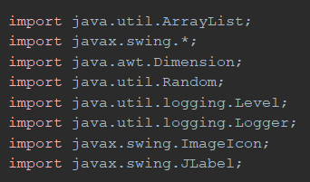
Libraries used!
}
< Together, these libraries allow the development of an interactive parking simulation with a visual interface, where the simulation can respond to changes in car arrivals and departures .… >

Slide 6
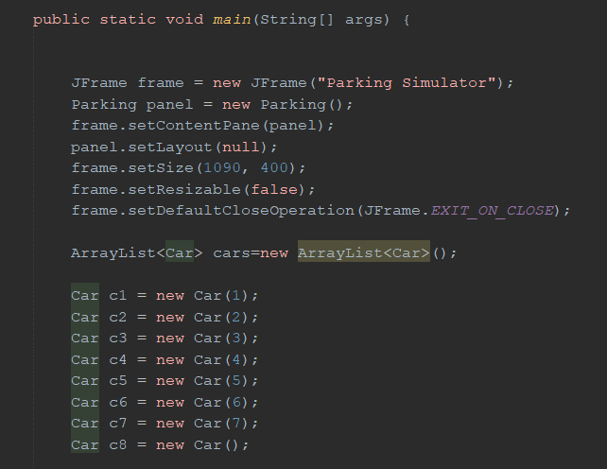
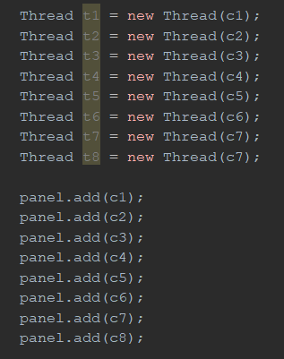
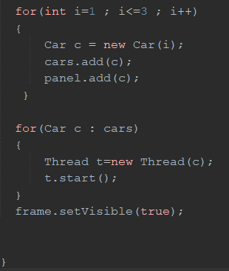
Program execution point
This code creates a parking simulator with 11 Car objects, each with its own thread, and displays them in a J Frame using a custom Parking panel.
}
..

Slide 7
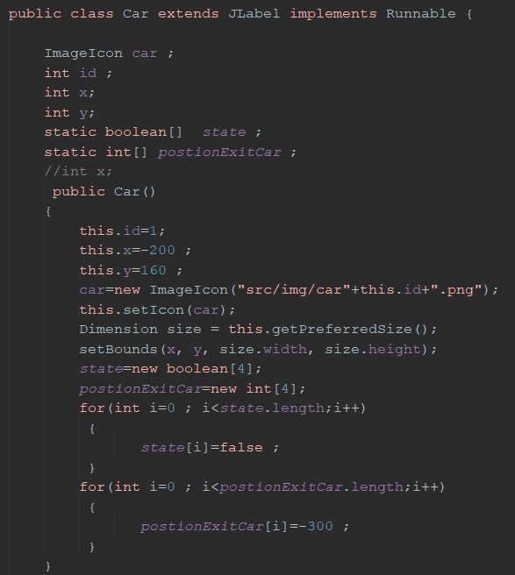
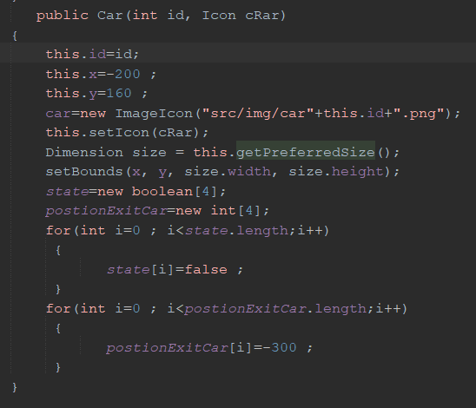
Class Car

Slide 8
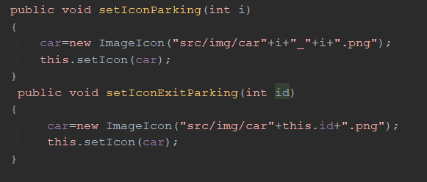
These two methods, set Icon Parking and set Icon Exit Parking, are used to set the icon of a car object to a specific image file, either a parking image or the original car image, based on the input parameter or the car's ID.
}
..

Slide 9



3 Cars
{
}
...

Slide 10
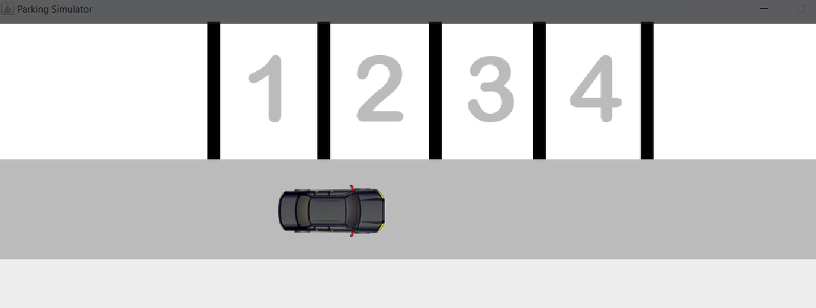
Output GUI

Slide 11
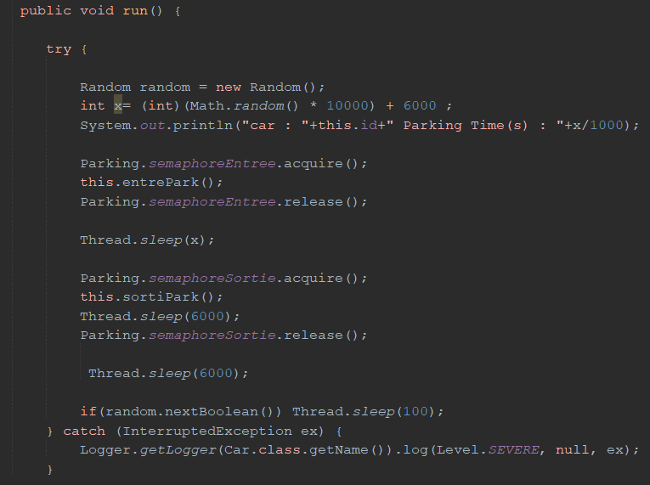
run() method
The run() method is where the logic for the car's behavior is implemented.

Slide 12
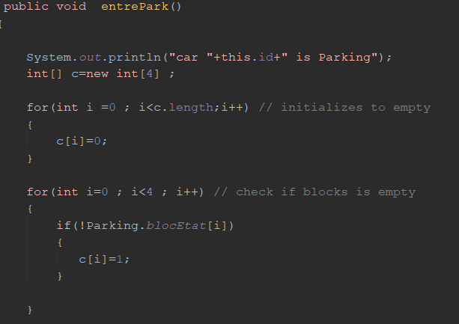
entre Park() method
The entre park() method :
initializes an array c to
represent the availability of parking spots, checks if each spot is empty,
and sets the corresponding index of c to 1 if it is.

Slide 13
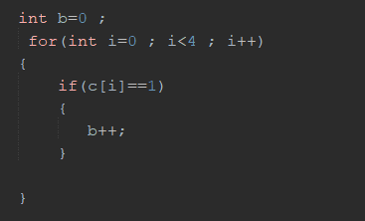
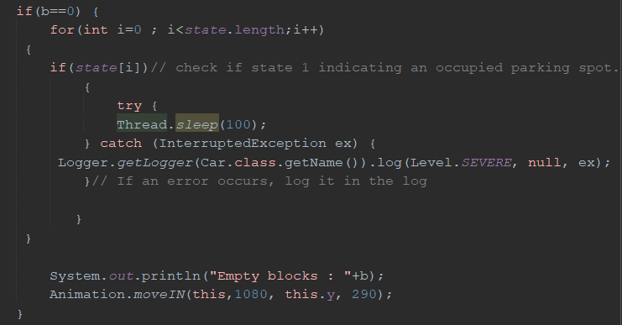
Complete entre Park() method
counts the number of available parking spots.
this code attempts to stop the execution of the current thread for 100 milliseconds. If anything goes wrong (such as a thread being cancelled), the exception will be caught and logged in the error log of the Car class.

Slide 14
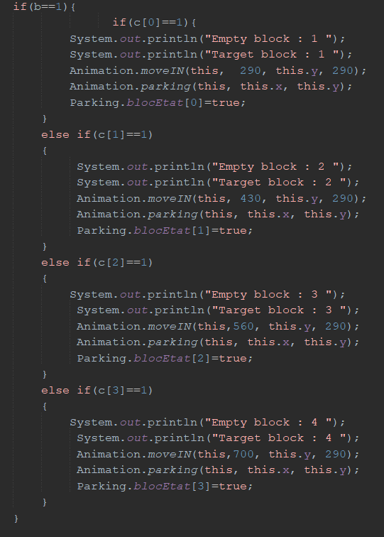
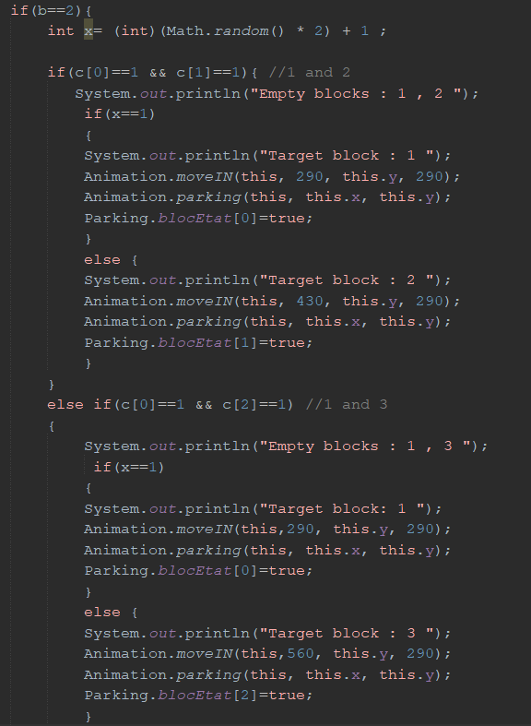

Slide 15
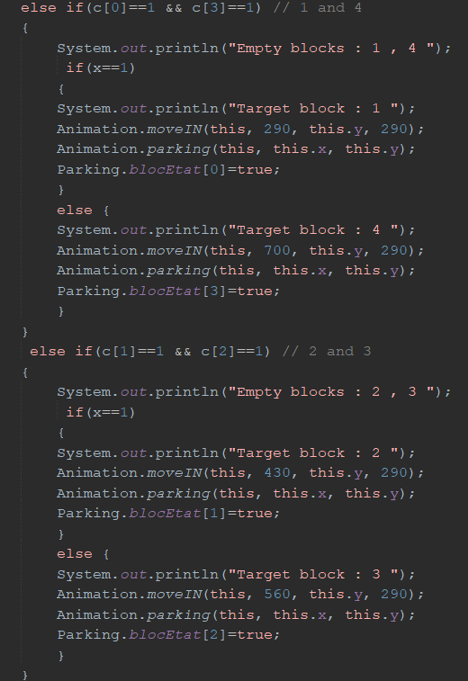
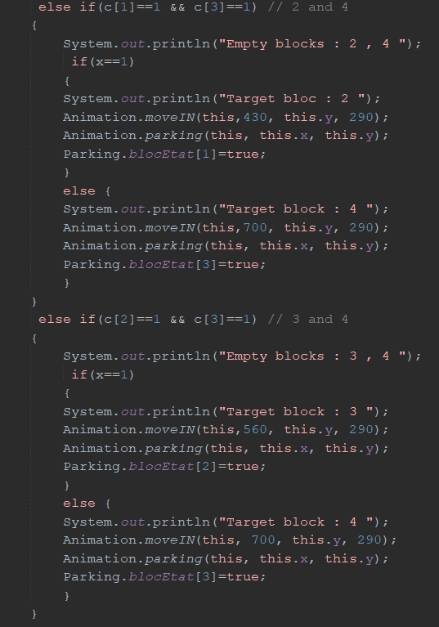

Slide 16
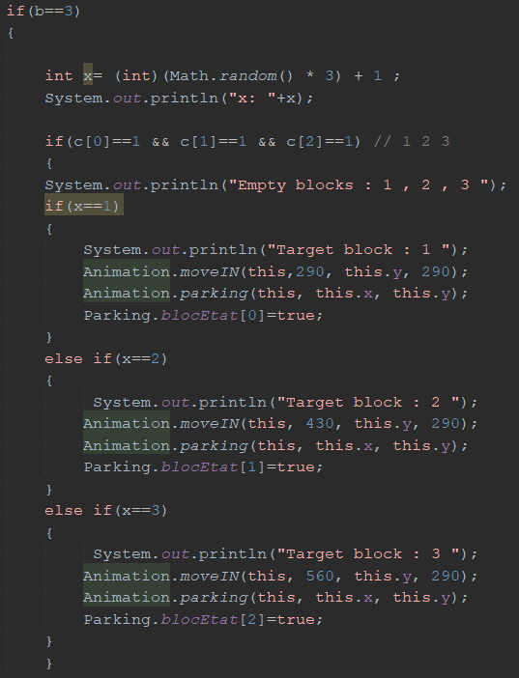
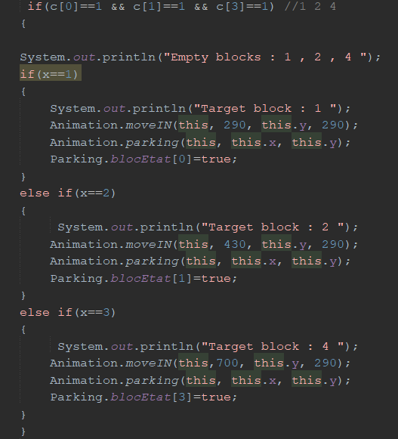

Slide 17
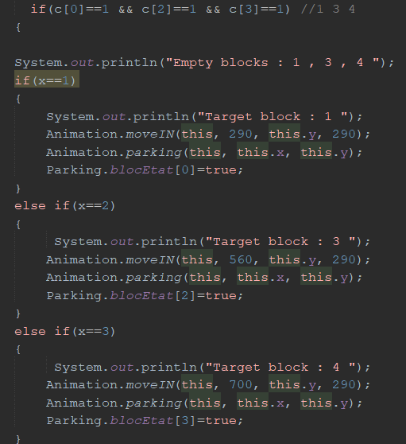
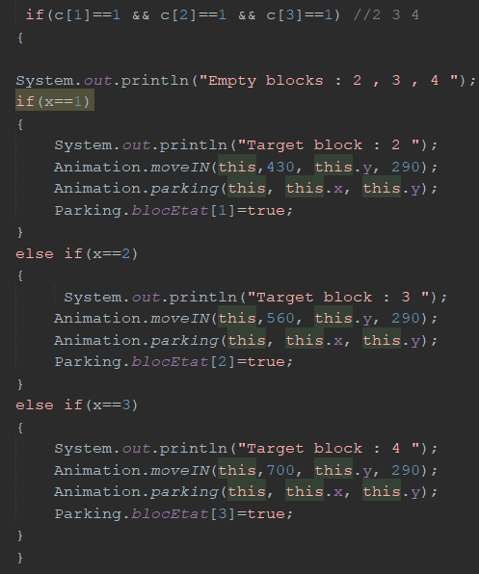

Slide 18
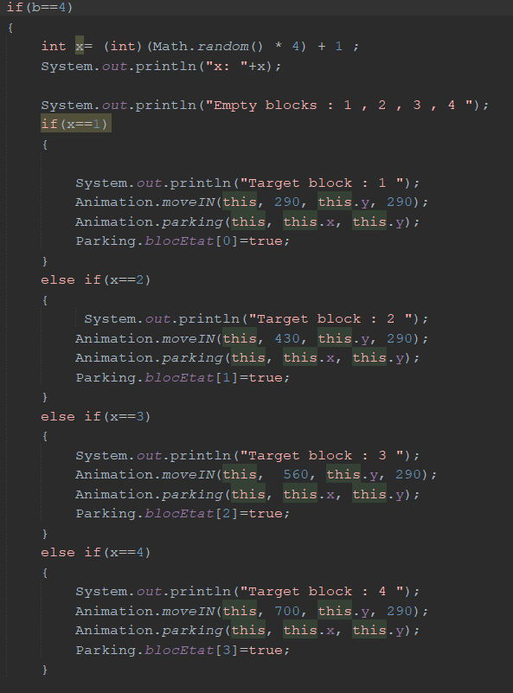
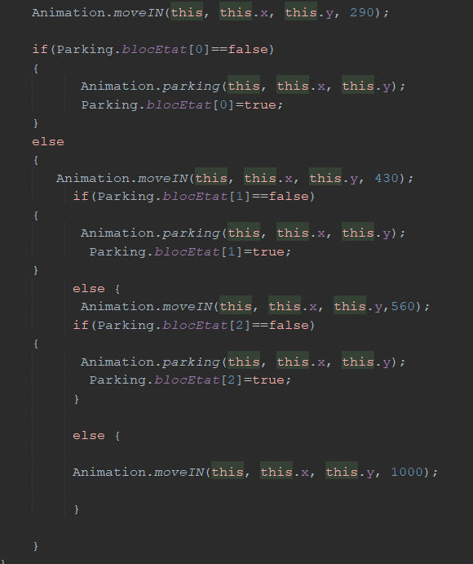

Slide 19
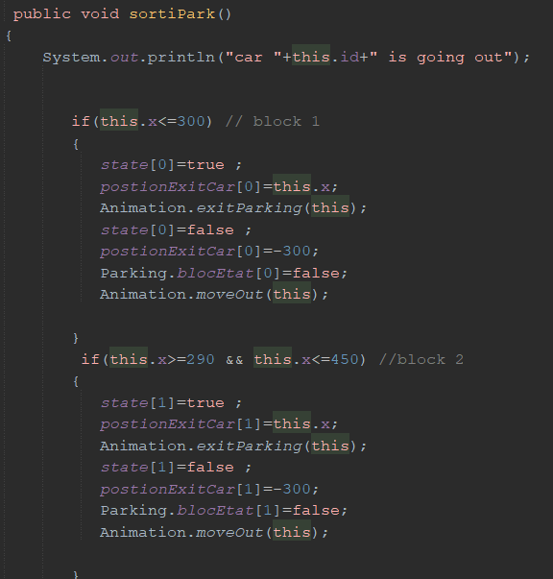
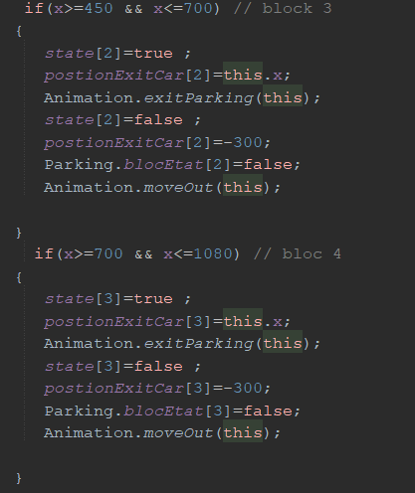
Sorti Park()method

Slide 20
Console Output
Expected Output:
Car : 3 Parking Times(s) : 7
Car : 1 Parking Times(s) : 12
Car : 2 Parking Times(s) : 15
Car 3 is Parking
X:4
Empty blocks : 1,2,3,4
Target Block : 4
Car 1 is Parking
Car empty blocks : 2,3
Target block: 3
car 3 is going out
car 2 is Parking
Empty blocks : 0
Car 1 is going out
}
..

Slide 21
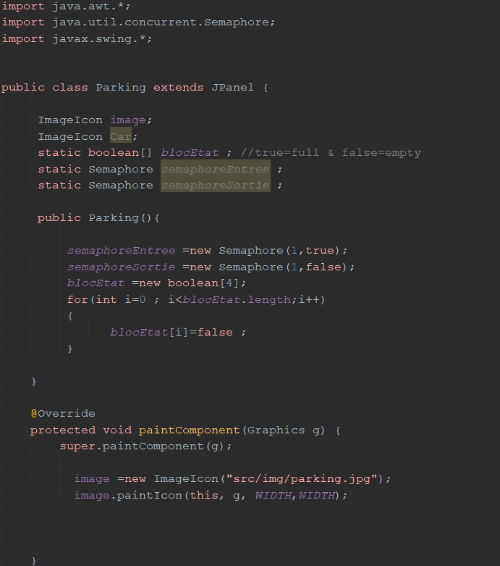
9h 55m 23s
333,000
386,000 km
Class Parking
Jupiter’s rotation period
The Sun’s mass compared to Earth’s
Distance between Earth and the Moon

Slide 22
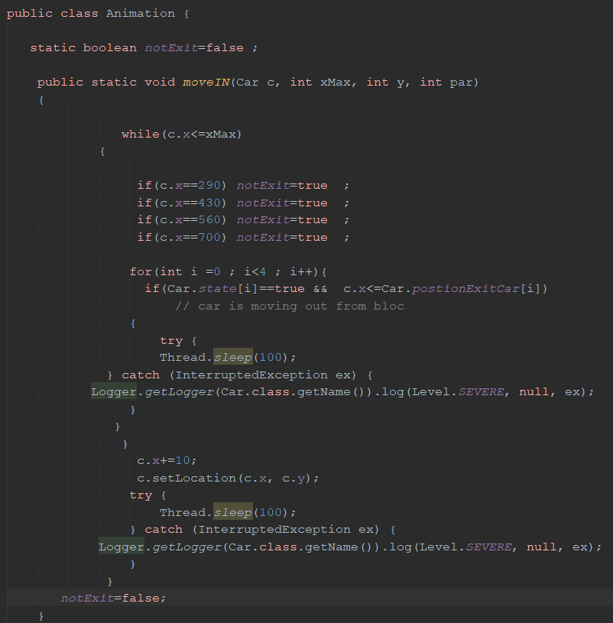
Class Animation
The move IN method animates a Car object moving from its current position to a maximum x-position (x Max) by incrementing its x-position and updating its location.
The method also checks for certain conditions, such as the car exiting a block, and sets a not Exit flag accordingly

Slide 23
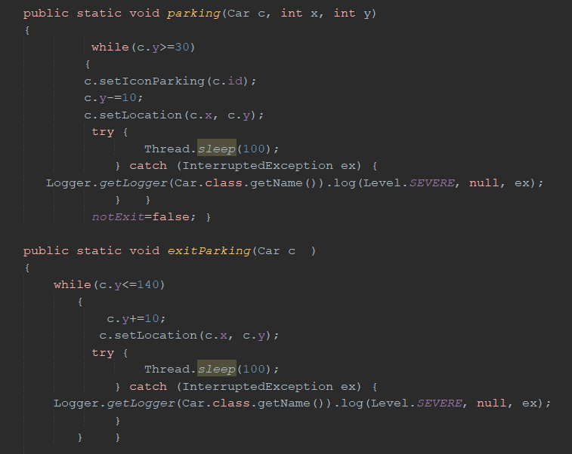
Complete
Class Animation
The parking method moves a car into a parking space by decrementing its y-position in 10-unit increments, updating its location, and pausing for 100ms between each step until it reaches y=30.
The exit Parking method moves a car out of a parking space by incrementing its y-position in 10-unit increments, updating its location, and pausing for 100ms between each step until it reaches y=140.

Slide 24
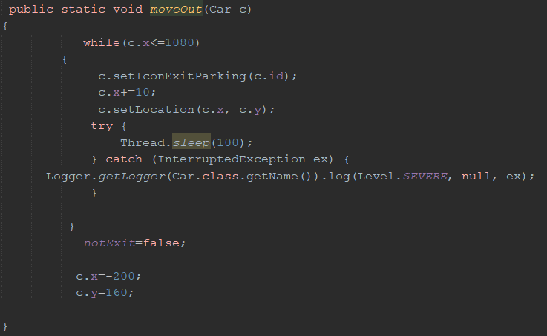
Complete
Class Animation
The move Out method
moves a car out of the parking lot by incrementing its x-position in 10-unit increments, updating its location, and pausing for 100ms between each step until it reaches x=1080. Once the car has exited the parking lot, its position is reset to x=-200 and y=160.

Slide 25
*
Thank you for listening
}

